Slide 1
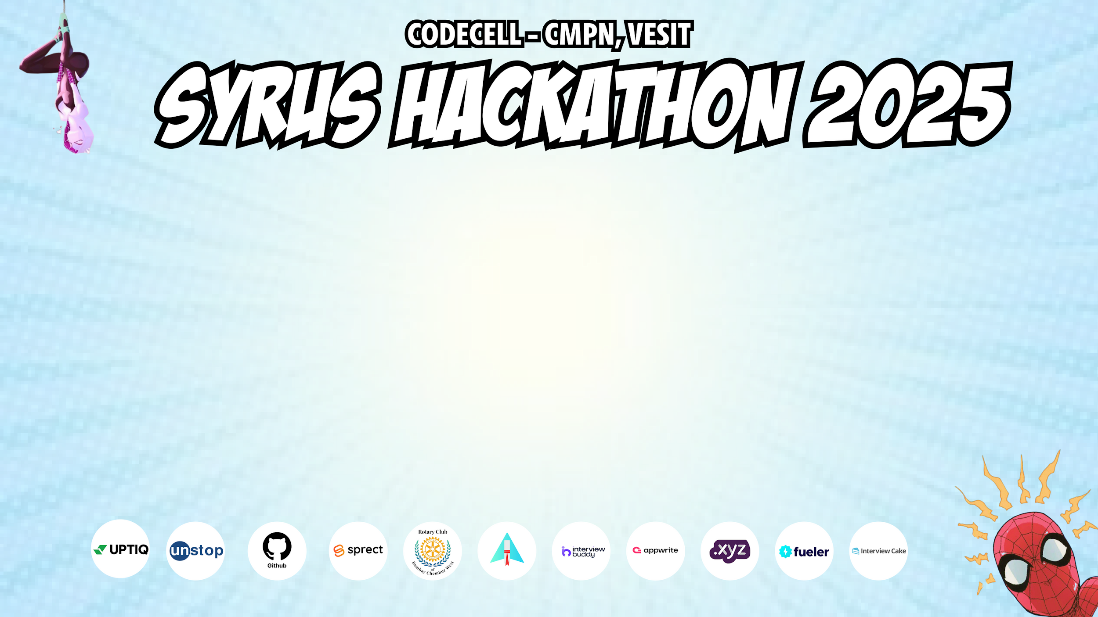
Category Code : C1
Problem Statement Title : MentorNet - AI-Powered Web3 Decentralized Mentorship Platform.
Team Name : Arjun[D]
Institute Name : Vivekanand Education Society’s Institute of Technology

Slide 2
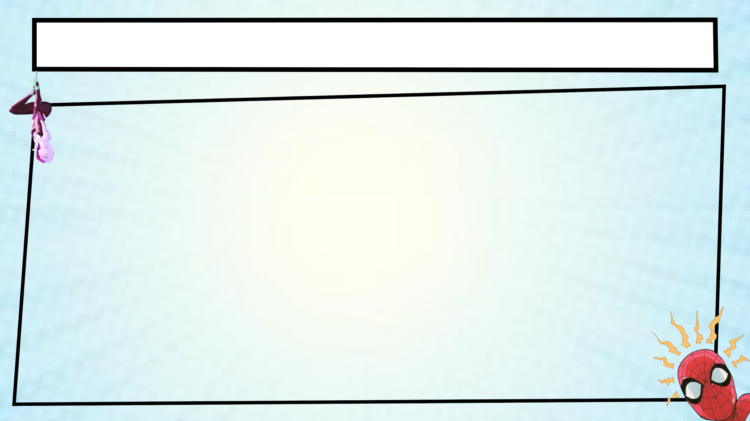
Idea / Approach details (with Problem Statement)
Millions of talented students struggle to find the right mentorship, career guidance and credible skill certification. The key challenges include :
Geographic Barriers - Limited access to experienced mentors based on location.
Financial Constraints - Often, quality mentorship is expensive and out of reach.
Networking Absence – Breaking into industries is hard without connections.
Unverified Skills – Traditional certificates can be forged, reducing credibility.
Our Solution : MentorNet
MentorNet is a global AI-driven mentorship platform that offers authentic and transparent career guidance to students worldwide, in a decentralized manner.
Secure & Transparent System – All data remains immutable, tamper-proof, and accessible, ensuring complete trust between mentors and students.
Personal Learning Journey tracks skill progress, projects and certifications in real time. It offers structured mentorship tailored to individual career goals.
MentorNet redefines mentorship by integrating trust, transparency and decentralized technology to ensure that every student gets the right guidance anytime, anywhere.

Slide 3
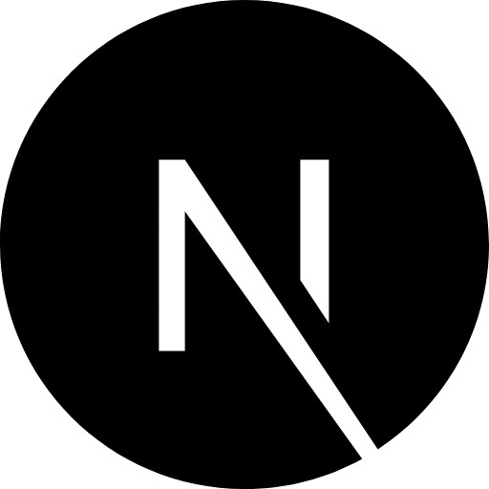
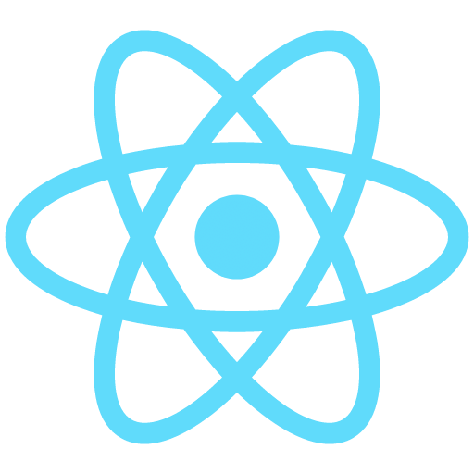


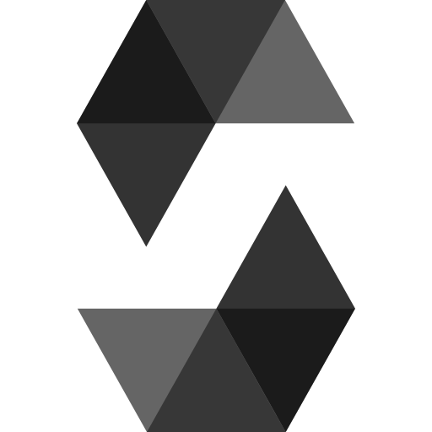

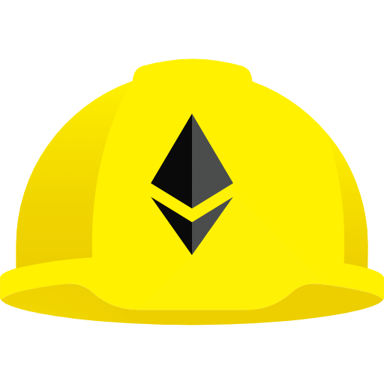
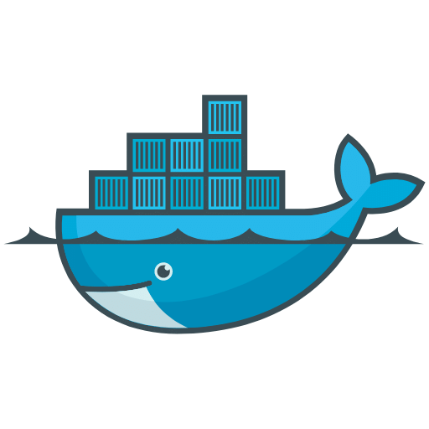


Technologies Used
Category | Tech Used
Frontend | Next.js 15, React 19, Tailwind CSS, shadcn/ui, Framer Motion.
Backend | Next.js Api Routes, Supabases [PostgreSQL] , Prisma Orm.
Blockchain | Solidity, Hardhat, Alchemy, Pinata (IPFS) & OpenZeppelin.
DevOps & Deployment | Vercel, Docker, Amazon EC2.

Slide 4
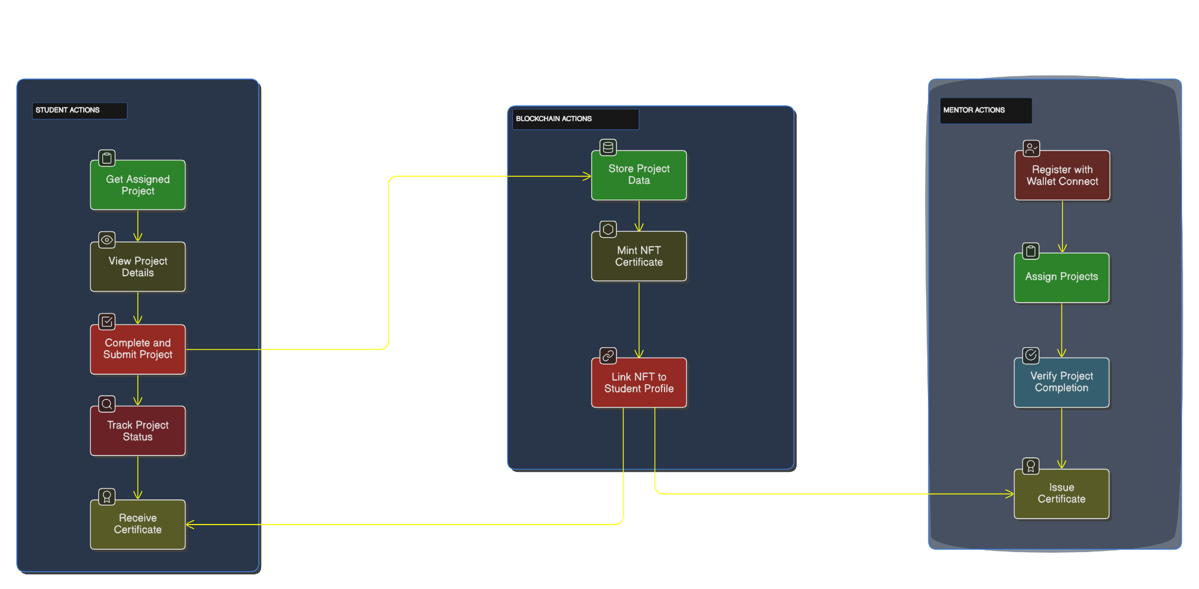
Flow Diagram / Architecture
MENTOR.NET FLOW

Slide 5
Implemented Features
User Dashboard built with Next.js 15 for a seamless and interactive experience with optimized rendering.
Smart Contract Deployment using Solidity on the Polygon (Amoy) testnet for secure, cost-effective, and scalable transactions.
Mentor Authentication with Wallet Connection using Wagmi and RainbowKit to ensure decentralized identity verification and security.
Decentralized Career Portfolio stores skills, projects, certificates, and mentorship sessions on IPFS with blockchain verification.
Learning Center with progress tracking mentor feedback and blockchain-powered career portfolios.
Marketplace for Courses & Skill NFTs where mentors offer courses students earn NFT-based certificates, and all transactions are verified on-chain.
AI Mentor Page utilizing LLMs for individualized advice career recommendations, and live industry updates.

Slide 6
Innovation (Showstopper)
1. AI-Driven Mentorship :
Leverages Large Language Models (LLMs) to provide individualized career advice.
Real-time skill gap analysis and adaptive learning paths.
AI-generated real world projects with expert feedback loops.
2. Decentralized Platform :
Constructed on the Web3 architecture with Mentor DAO.
Community-involved administration utilizing token-based motivation for mentors.
Transparent and immutable mentor-student interactions.
3. Mentorship Marketplace & Skill NFTs :
A decentralized hub for mentorship programs and verified skill-based NFTs.
Delivers on-chain attestation of skills and career accomplishments.
4. Real-Time Industry Insights & Career Roadmaps :
AI analyses market trends to recommend in-demand skills.
It dynamically updates career pathways based on evolving job needs.

Slide 7
Future Scope
MentorNet may grow into a next-gen decentralized career ecosystem. It will enhance mentorship, skill validation, and learning experiences. Future possibilities include :
Soulbound Token Certifications – This is about implementing non-transferable blockchain-based certificates. The aim is to ensure verified and tamper-proof skill validation.
Live Mentorship & Peer Learning – Facilitate real-time mentor-student interactions, expert-led sessions and collaborative learning environments.
Gamified Learning Experience – Interactive challenges, skill-based quests, and reward-driven learning make mentorship engaging and effective.
DAO-Based Governance – Building a Mentor DAO to involve the community in decision-making, platform updates, and governance.
Multi-Chain Expansion – Scaling MentorNet across multiple blockchain networks to optimize costs, security, and global reach.
These developments can convert MentorNet into an entirely decentralized, AI-driven mentorship platform, guaranteeing inclusive career growth opportunities.

